Slide 1
Multi-Period Optimal Power Flow (MP-OPF) for Power Distribution Systems with Battery Storage
Aryan Ritwajeet Jha
Graduate Research Assistant¹
Under the supervision of
Dr. Anamika Dubey, Associate Professor¹ and mentored by Dr. Subho Paul, Postdoctoral Research Associate¹
¹ Energy Systems Innovation Center, School of Electrical Engineering and Computer Science, Voiland College of Engineering, Washington State University, Pullman
Notes:
Remember to hit the reset button to make sure all the page elements react properly.
There are 20 different layouts that you can choose from.

Slide 2

Multi-Period Distributed-OPF simulation of a grid with DERs and Battery Storage

Slide 3
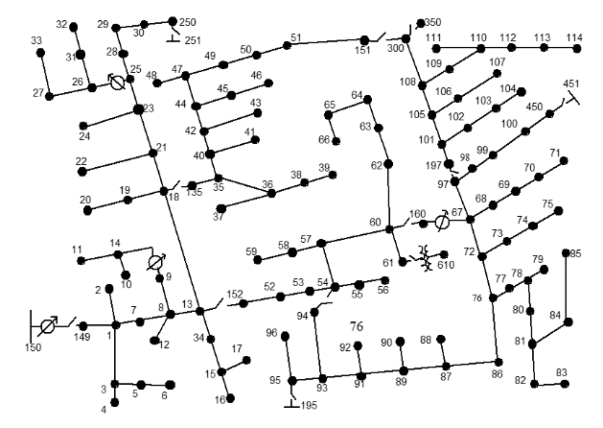
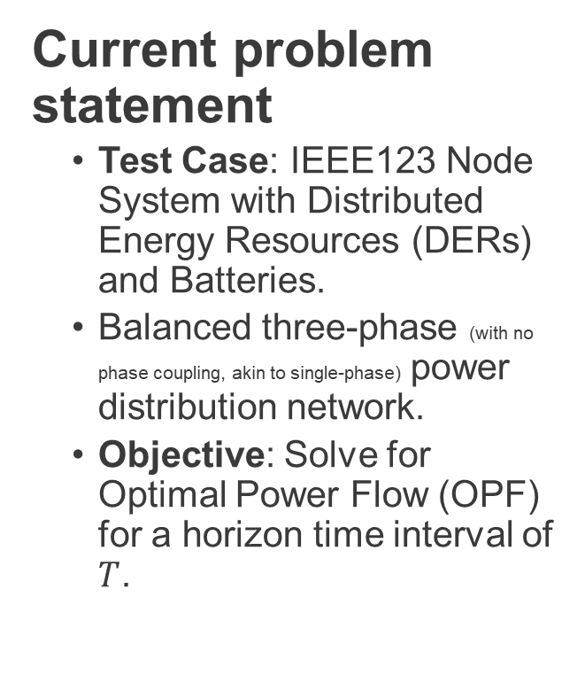
The Network
Current problem statement
Test Case: IEEE123 Node System with Distributed Energy Resources (DERs) and Batteries.
Balanced three-phase (with no phase coupling, akin to single-phase) power distribution network.
Objective: Solve for Optimal Power Flow (OPF) for a horizon time interval of $T$.

Slide 4
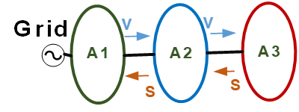
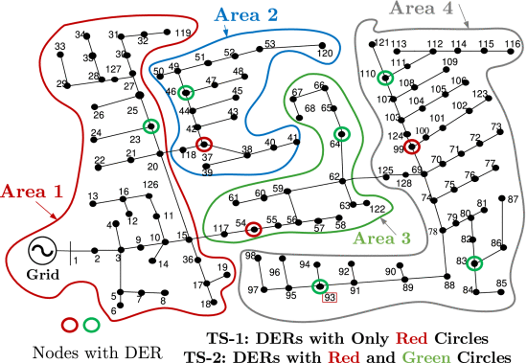

The Network
A previous model of the test system. Currently the system has DERs and Batteries on $50\%+$of the nodes and have a combined capacity of $67\%$ of the total demand power.
Figure Courtesy: Dr. Subho Paul
ENApp Approach [1]
Divide the network into several areas to solve for their Optimal Power Flow solutions separately, with exchange of boundary variables after every ‘macro-iteration’.

Slide 5
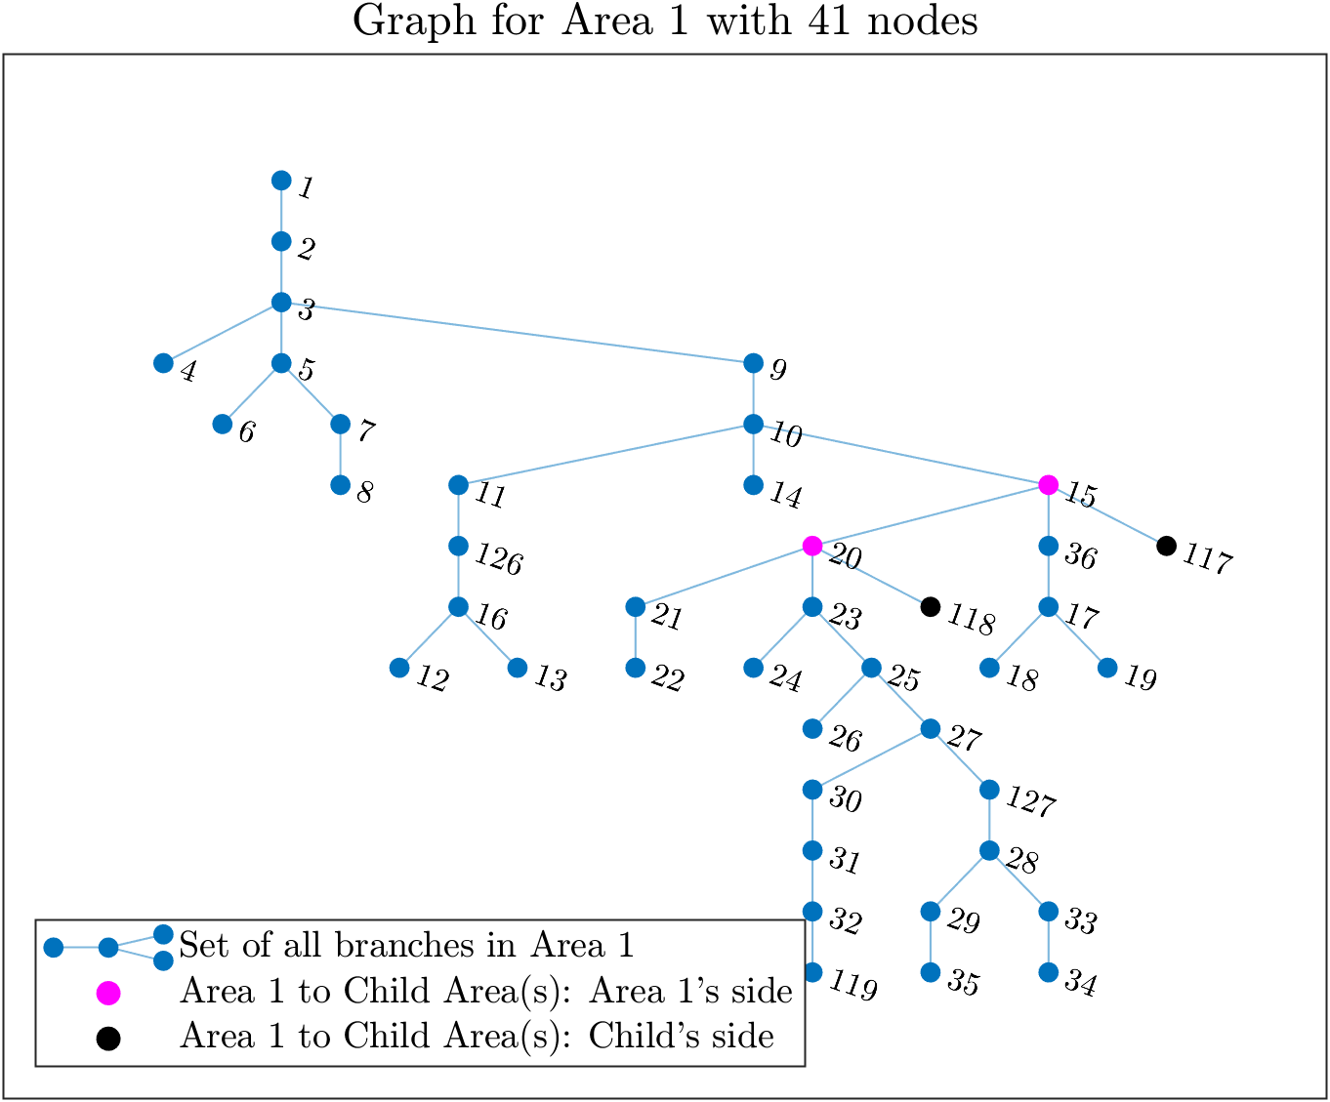
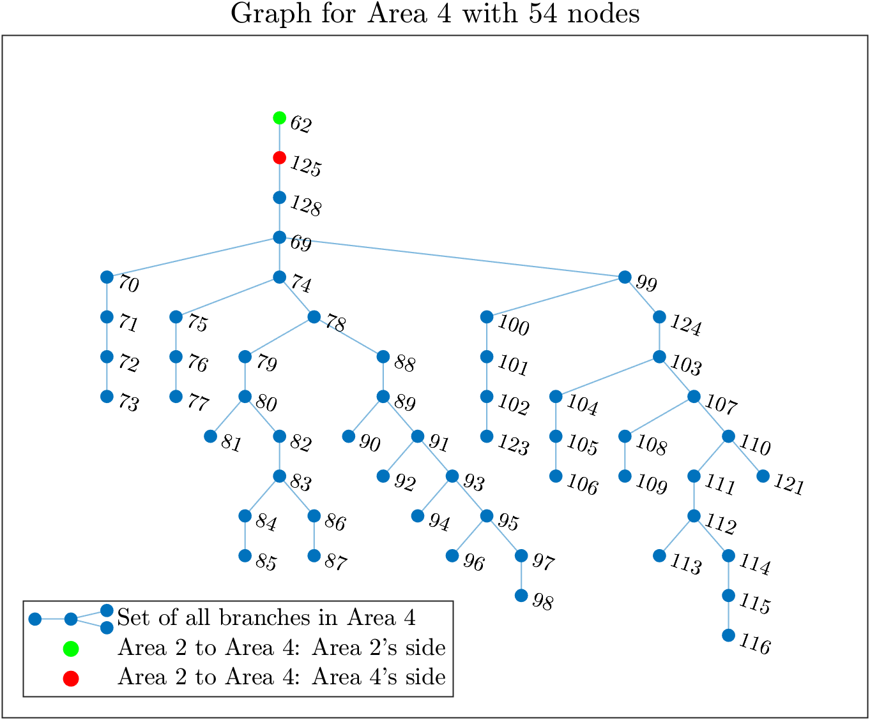
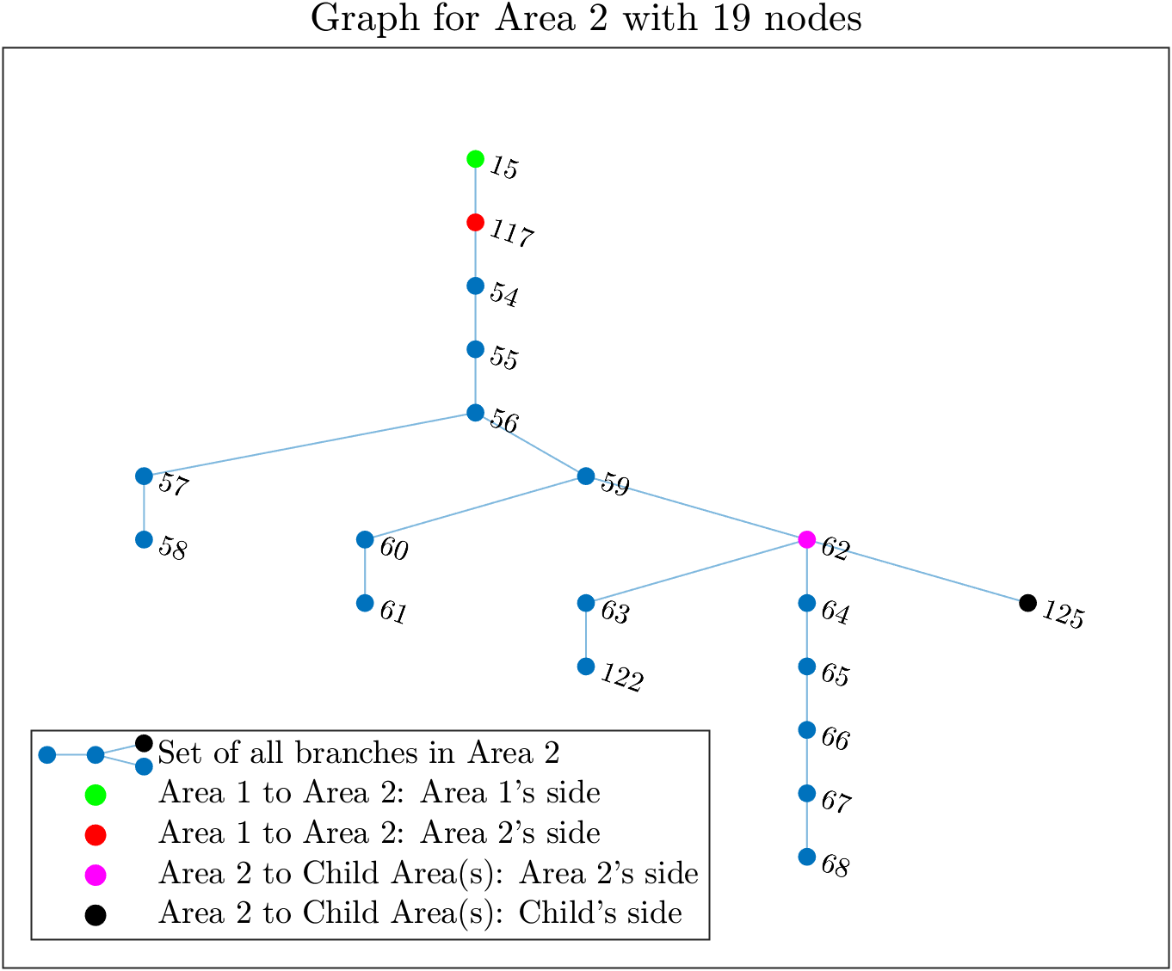
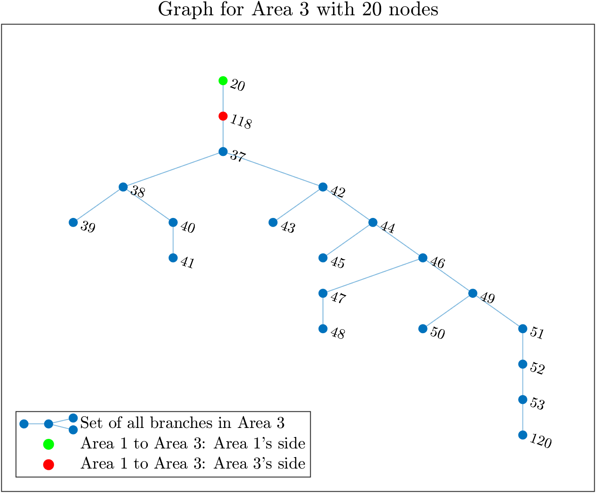
(IEEE 123 System divided into) 4 Area System

Slide 6
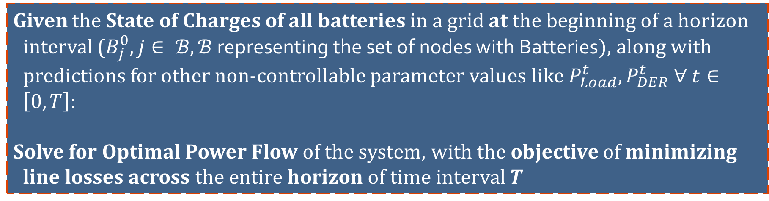
Problem Statement
Given the State of Charges of all batteries in a grid at the beginning of a horizon interval ($B_{j}^{0}, j∈ ℬ, ℬ$ representing the set of nodes with Batteries$)$, along with predictions for other non-controllable parameter values like $P_{Load}^{t}, P_{DER}^{t} ∀ t∈\left[0, T\right]$:
Solve for Optimal Power Flow of the system, with the objective of minimizing line losses across the entire horizon of time interval $T$

Slide 7

Problem Statement
Given the State of Charges of all batteries in a grid at the beginning of a horizon interval ($B_{j}^{0}, j∈ ℬ, ℬ$ representing the set of nodes with Batteries$)$, along with other non-controllable parameter values like $P_{Load}, P_{DER}$:
Solve for Optimal Power Flow of the system, with the objective of minimizing line losses across the entire horizon of time interval $T$
while making sure that:
1. $B_{t}$ (the SOC of the battery at every point of the simulation) stays in permissible limits
2. The OPF Solution is physically consistent. For no node containing a battery, is $P_{d}^{t}. P_{c}^{t}≠0$. In other words, make sure that Complementarity of Discharging and Charging is ensured. Alternatively, Simultaneous Charging and Discharging (SCD) is avoided.
3. Other usual OPF physical constraints are also satisfied.

Slide 8

Simulation Parameters
Objective: Minimize Line Losses for whole horizon
System: IEEE $123$ Node System
Phase: Balanced $3∅$ (no phase coupling)
Supply: DERs (PVs): Forecasted, varying with $t$. Batteries at select (about $50\%$ of total) nodes. Substation.
Demand: Forecasted. Varying with $t$
Control: Inverter Reactive Power Control for DERs and Batteries. Battery Charging/Discharging.
Number of discrete time-steps: $T= 7$
Duration per time-step: $Δt=15$min.

Slide 9

Simulation Process of the current, brute-force algorithm
Start
--------------------------------------------
Known:
$B_{j}^{0}, P_{DER_{j}}^{t}, P_{Load_{j}}^{t} ∀ t∈\left[0, T\right], j∈Ν$
---------------------------------------------
while “(Spatial) boundary variables are NOT equal in value for all connected parent-child areas”
Run OPF for minimizing the losses across the horizon for each area, in parallel. This is called as a macro-iteration.
Exchange (spatial) boundary variables between all sets of connected parent-child areas.
End
-----------------------------------------------
Stop

Slide 10

[In development] Simulation Process of Spatially and Temporally Decomposed OPF algorithm.
Start
------------------------------------------------------------------------
Known:
$B_{j}^{0}, P_{DER_{j}}^{t}, P_{Load_{j}}^{t} ∀ t∈\left[0, T\right], j∈Ν$
-----------------------------------------------------------------------
while “temporal boundary variables are NOT equal in value for all consecutive time intervals”
while “spatial boundary variables are NOT equal in value for all connected parent-child areas”
Run (D-)OPF for minimizing the losses across the horizon for each area, in parallel. This is called as a macro-iteration.
Exchange spatial boundary variables between all sets of connected parent-child areas.
end
Exchange temporal boundary variables between consecutive time intervals
end
------------------------------------------------------------------------
Stop

Slide 11
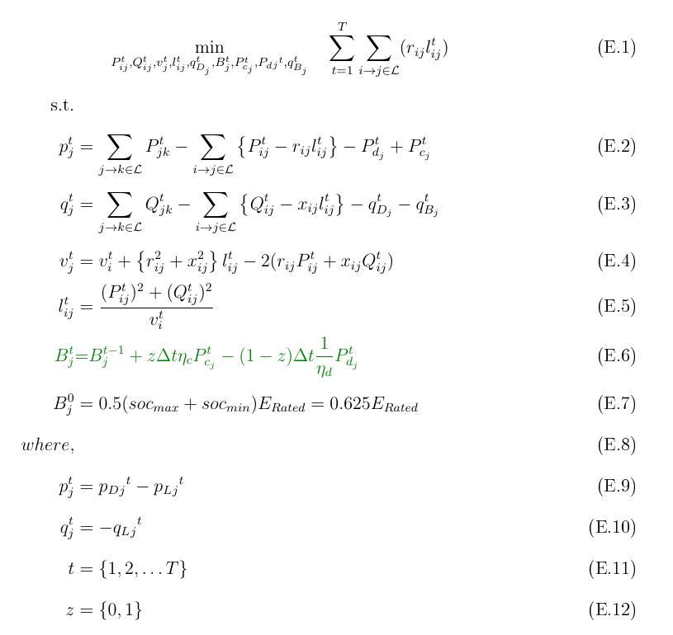
Optimization Formulation
Mixed-Integer Non-linear Optimization Problem

Slide 12
Optimization Formulation
Mixed-Integer Non-linear Optimization Problem
Line Losses
Battery State of Charge Equation (this equation is temporally coupled, or has ‘memory’)
Real Powerflow from a bus into the network
Reactive Powerflow from a bus into the network
Kirchhoff's Voltage Law (KVL)
Current Magnitude in a branch
DER Generation (forecasted, non-controllable)
Complementarity of Charging and Discharging during a particular time interval.
Loads (forecasted, non-controllable)

Slide 13
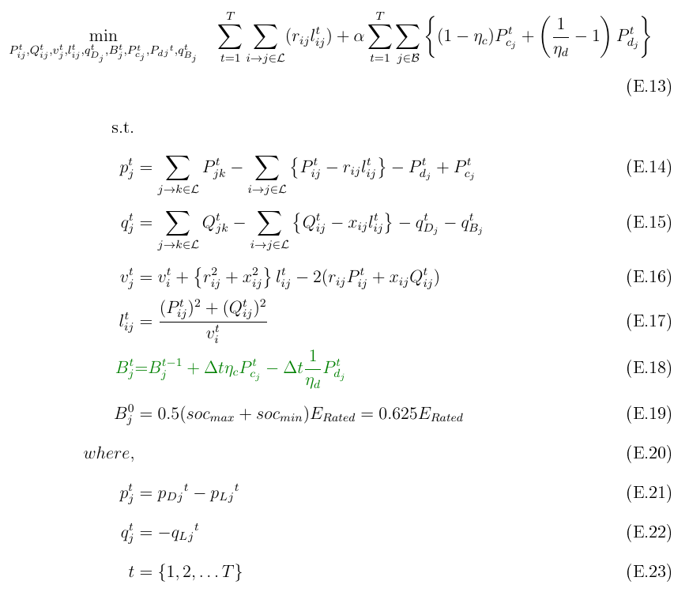

Optimization Formulation
(Integer-Constraint Relaxed) Non-linear Optimization Problem
Line Losses
Real Powerflow from a bus into the network
Reactive Powerflow from a bus into the network
#Types of variables
$$9T$$
#Variables
$$4mT+n_{DERT}T+4n_{Batt}T$$
#Equality Constraints $4mT+n_{Batt}T$
(Non-Linear)
Kirchhoff's Voltage Law (KVL)
Current Magnitude in a branch
DER Generation (forecasted, non-controllable)
Loads (forecasted, non-controllable)

Slide 14
Optimization Formulation
(Integer-Constraint Relaxed) Non-linear Optimization Problem
Line Losses
‘Green Box’ Term
Battery State of Charge Equation (temporally coupled) with complementarity relaxed.
Real Powerflow from a bus into the network
Reactive Powerflow from a bus into the network
Extra expression added to the objective function to penalize any SCD.
Why? Want to avoid SCD, but don’t want to solve for a Mixed-Integer Problem.
Kirchhoff's Voltage Law (KVL)
Current Magnitude in a branch
DER Generation (forecasted, non-controllable)
Loads (forecasted, non-controllable)

Slide 15


Implementation Details
Platform, Input, Output
Platform:
Current Implementation is in MATLAB.
But Python/Julia can be used to implement the same.
Inputs:
Inputs are the same as Powerflow variables for a distribution system. That means: Topography:
busData: $\left(∀ j∈N\right) {P_{G}}_{j}, Q_{G_{j}}$, $P_{L_{j}}, Q_{L_{j}}, {|V}_{j}|$ $[kW, kVAr, kV or pu]$
branchData: $\left(∀ i→j∈L\right) Z_{ij}=R_{ij}+jX_{ij}$ $[Ω or pu]$
Power Demand Forecast Profile $[kW]$
PV Forecast Profile $\left[kW\right]or λ$
PV Real Power/Reactive Power Limits $[kW]$
Battery Charging/Discharging Limits $[kW]$
Battery SOC Limits $[kWh]$
What kind of objective function? Cost of Generation? Then give an estimate of Cost of substation power, cost of battery charging and cost of discharging power $[\$/kW]$.
Outputs:
Optimal value of the objective function (say, line losses $P_{Loss}$ in $kW$ or Cost of generation in $\$$).
All state/control/output optimal variables. Such as: The nine optimization variables for all time instances across the horizon: $P_{ij}^{t}, Q_{ij}^{t}, l_{ij}^{t}, v_{j}^{t}, q_{D_{j}}^{t}, B_{j}^{t}, P_{c_{j}}^{t}, P_{d_{j}}^{t}, q_{B_{j}}^{t} ∀ t∈\left[0, T\right], j∈N, \left(i→j\right)∈L$
Output variables such as Substation Power $P_{Subs}$.
Any other relevant variables.

Slide 16
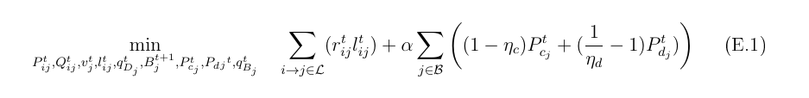
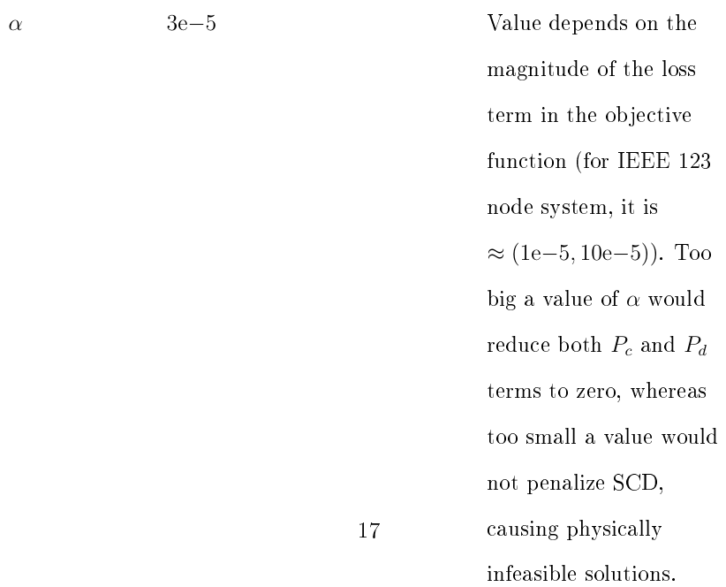
Implementation
$α$ – The Coefficient for the Green Box term penalizing SCD

Slide 17

Implementation Note
The cost of replacing the Boolean Constraints with the SCD Green Box term for avoiding SCD.
Handle SCD (Green Box) term with care.
While it has helped us relax the constraint of Boolean Variables in the optimization modelling and solving, it needs extra caution for modelling in order to arrive at a useful solution.
For example, it cannot be used alone without the main objective function, such as loss minimization. Otherwise, the optimizer will penalize any participation of the batteries, making both $P_{C_{j}}=0$and $P_{D_{j}}=0$for all batteries.
$α$ needs to be carefully designed. The value of the SCD Green Box should be within a magnitude range of the line loss function’s value. Too greater, and it would reduce battery power to zero, too low, and SCD might occur.

Slide 18
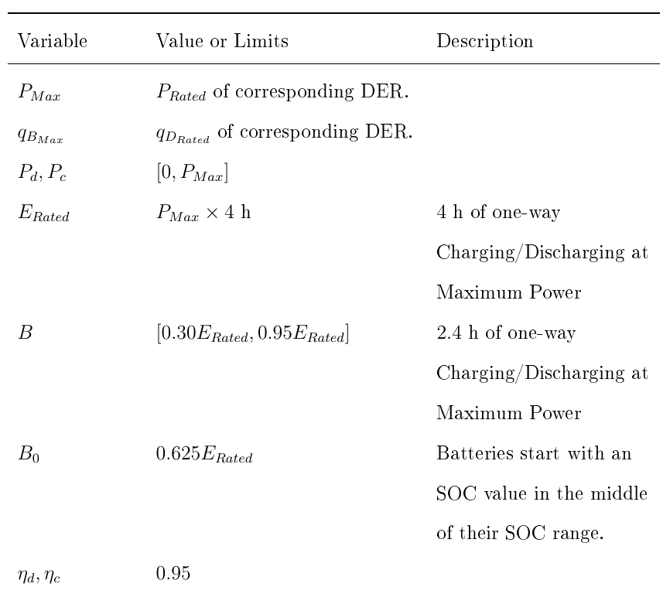
Bounds and Values
Battery State/Control Variables

Slide 19
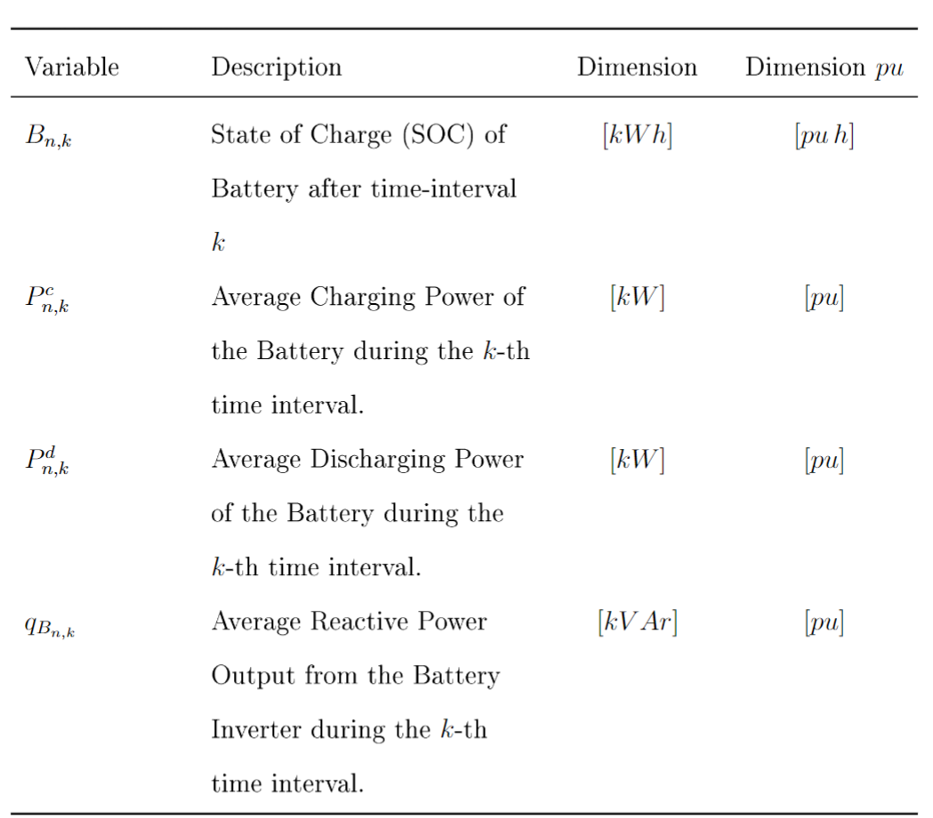
Reference of Notation: Battery Variables

Slide 20
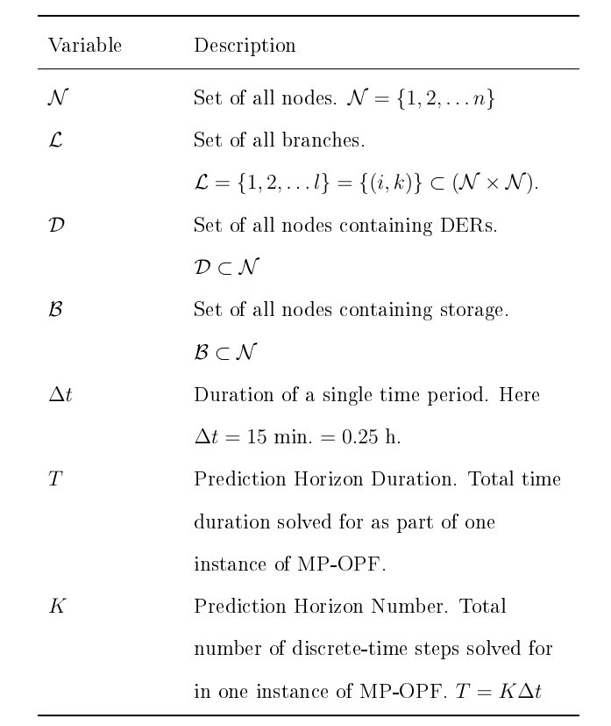
Reference of Notation: Grid-level Notation
Helpful for clarifying any variable in the optimization formulations.

Slide 21
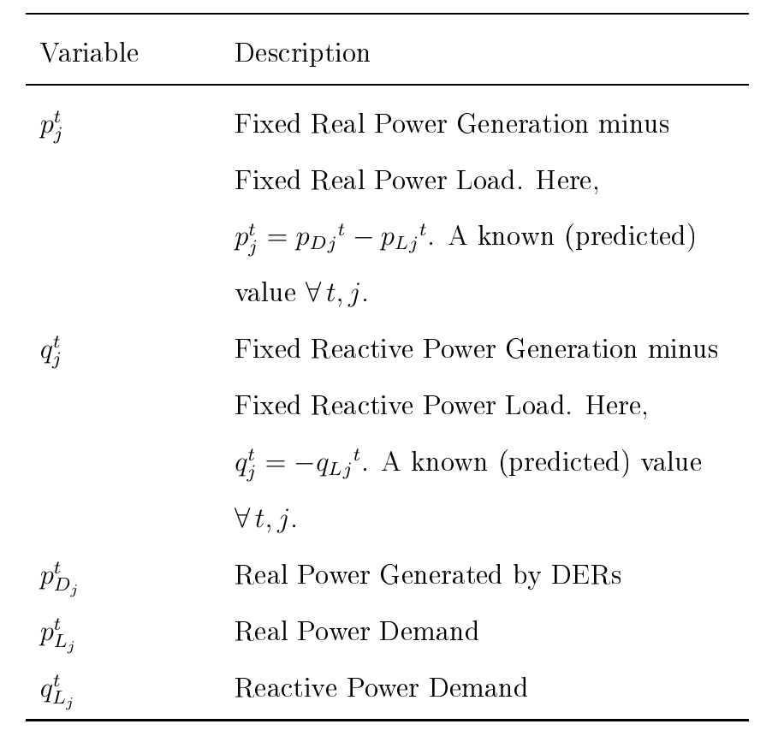
Reference of Notation: Branch Flow Model and DER variables
Helpful for clarifying any variable in the optimization formulations.

Slide 22
References
[1] Sadnan, R., & Dubey, A. (2022). Distributed Computing for Scalable Optimal Power Flow in Large Radial Electric Power Distribution Systems with Distributed Energy Resources. arXiv, 2211.03920. Retrieved from https://arxiv.org/abs/2211.03920v1

